Slide 1
Redis
By Altotech

Slide 2

Redis
Redis is an open source (BSD licensed), in-memory data structure store, used as a database, cache and message broker.
It supports various data structures such as Strings, Hashes, Lists, Sets etc.

Slide 3
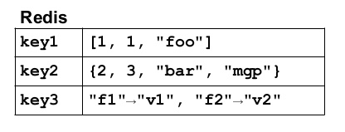
Key: Value

Slide 4
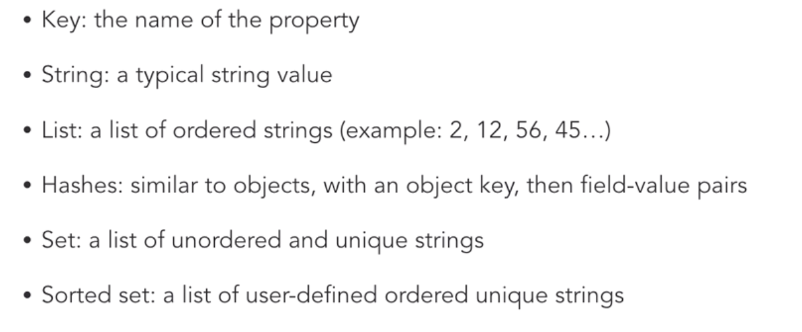
Data Types

Slide 5
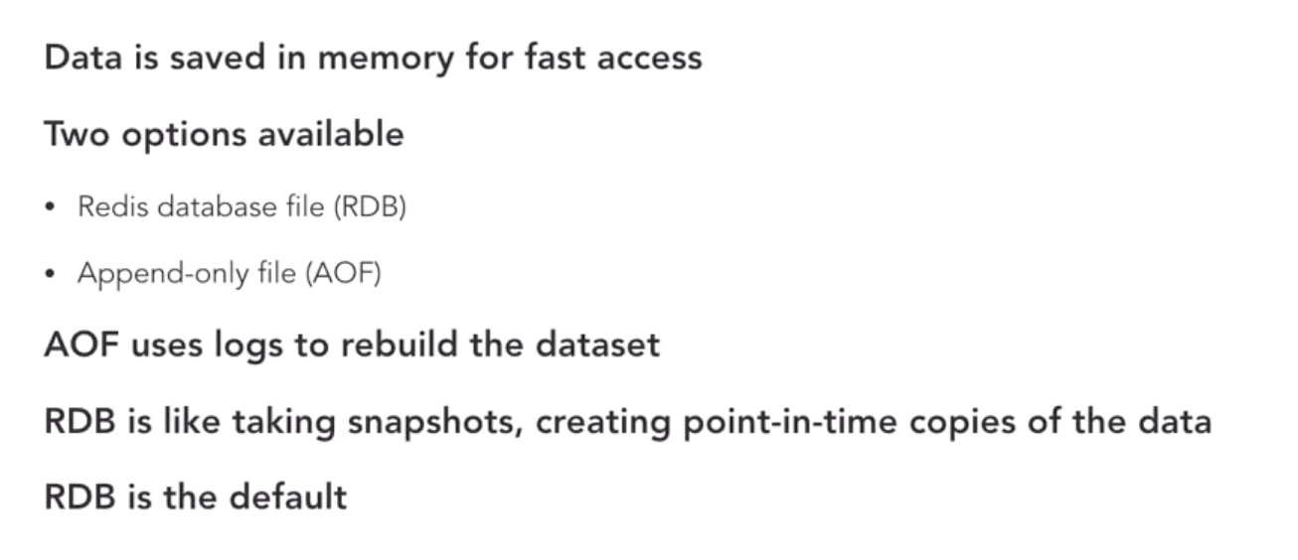
Redis Persistence

Slide 6
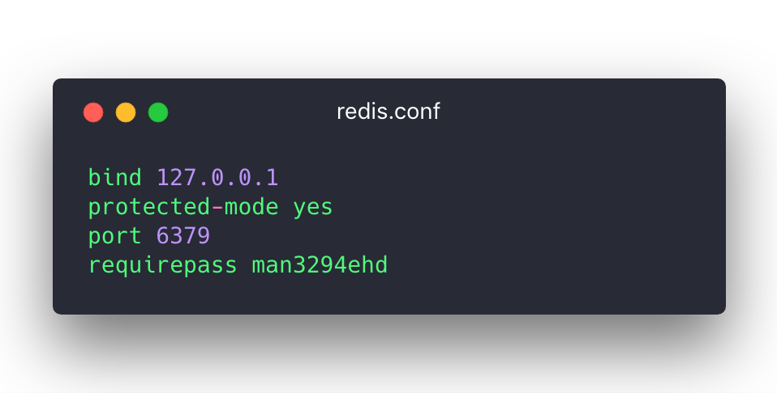
Redis Security

Slide 7
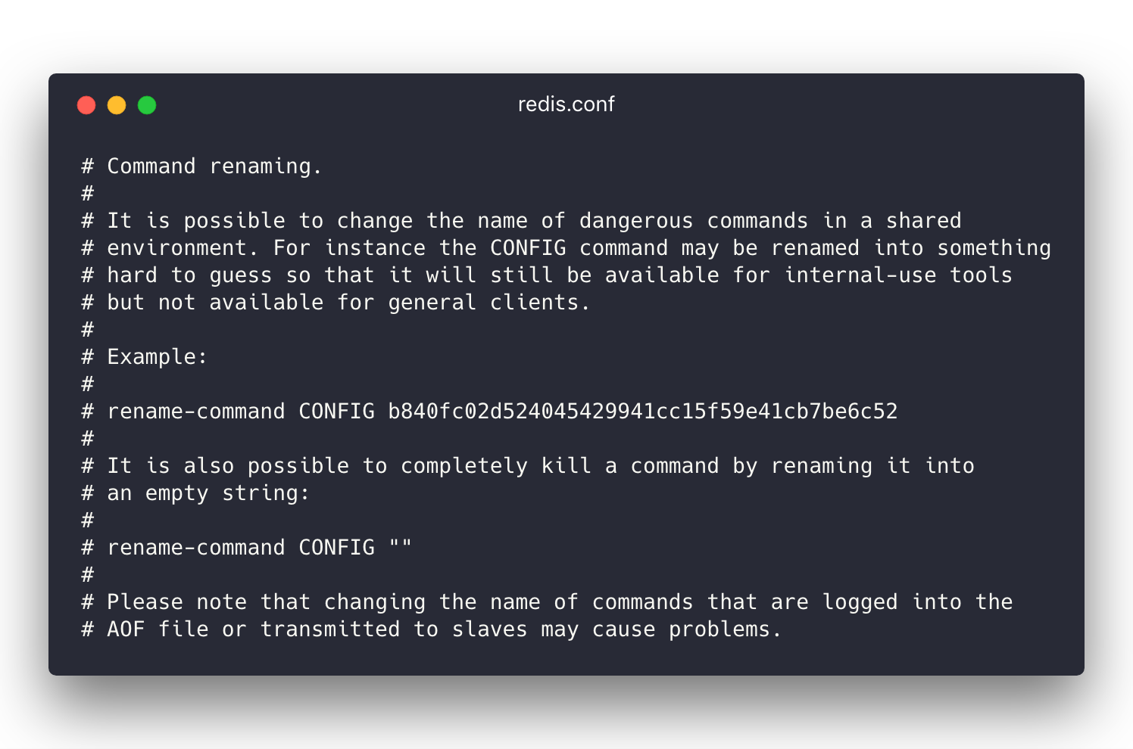

Slide 8
Get Started with redis
GO TO
http://try.redis.io/

Slide 9
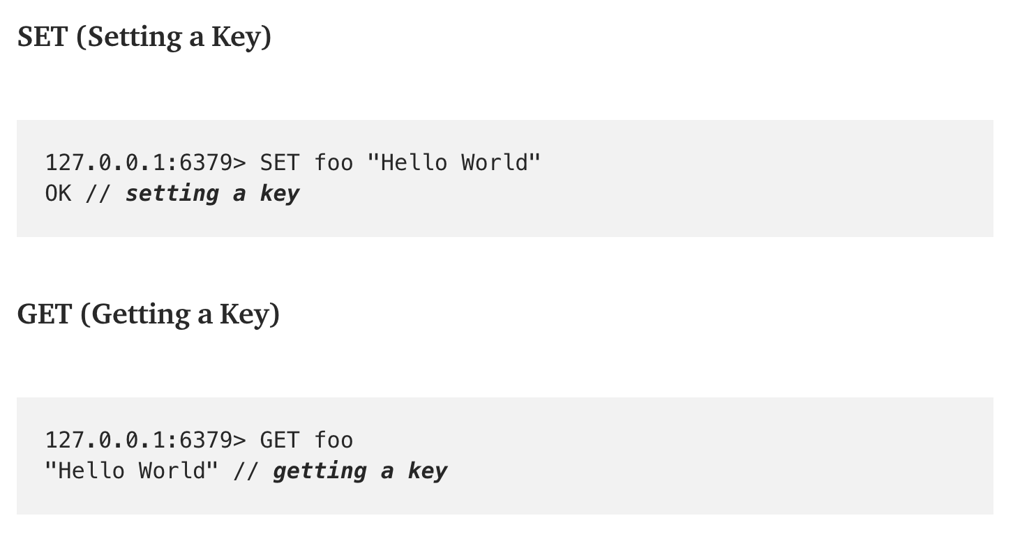
Redis command

Slide 10
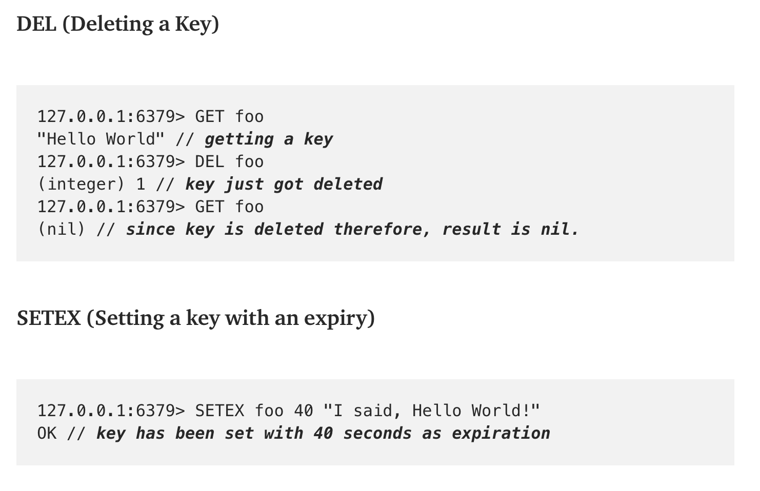
Redis command

Slide 11
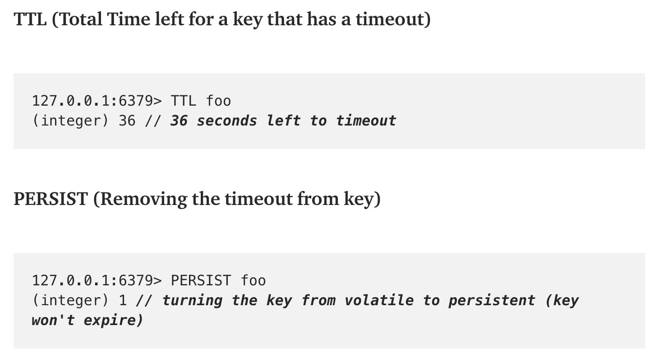
Redis command

Slide 12
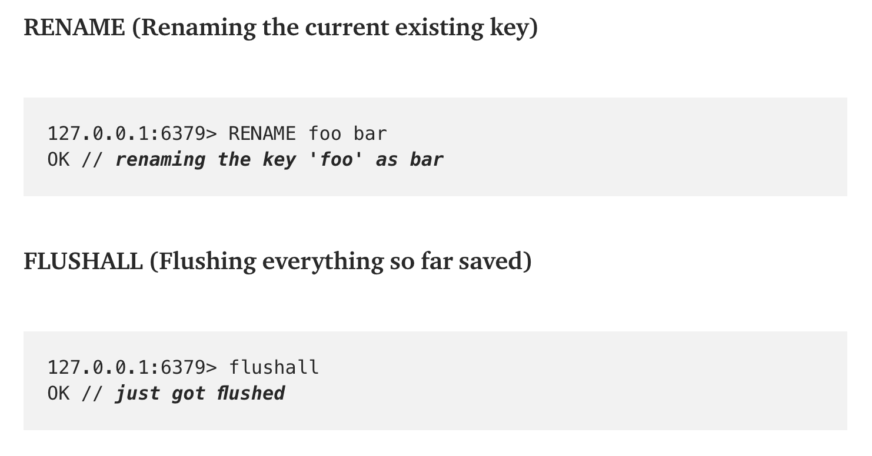
Redis command

Slide 13
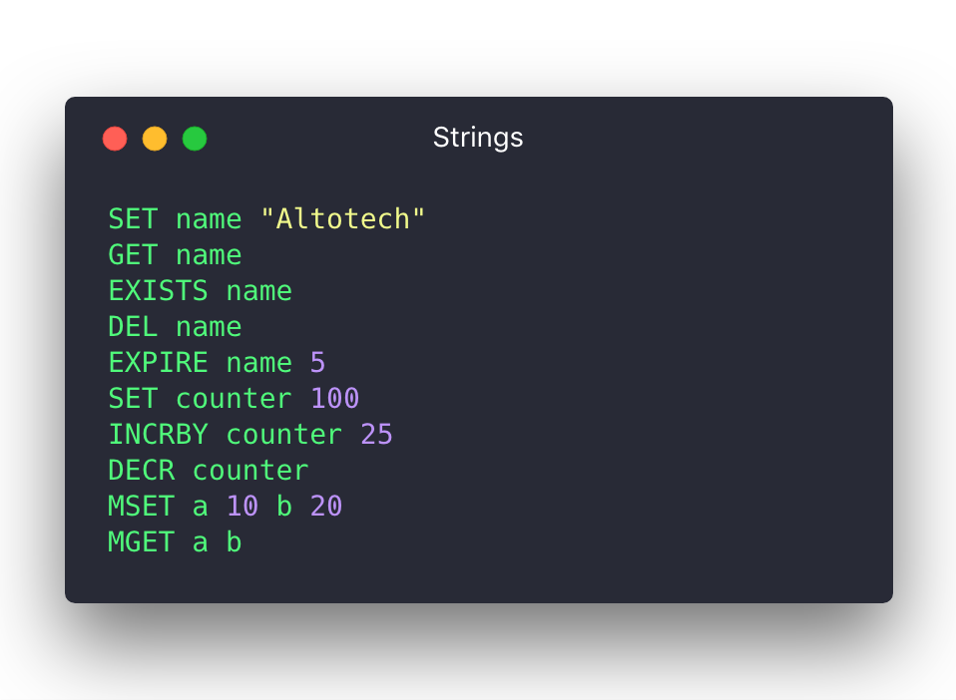
Redis command: Strings

Slide 14
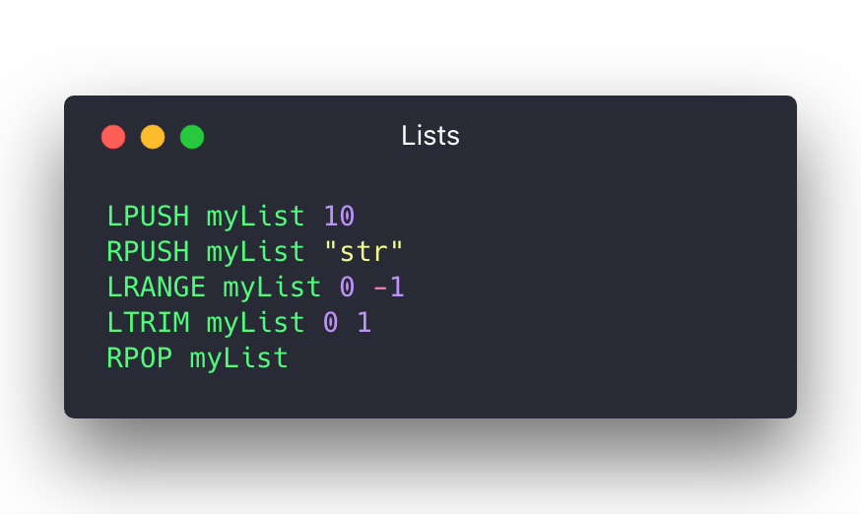
Redis command: Lists

Slide 15
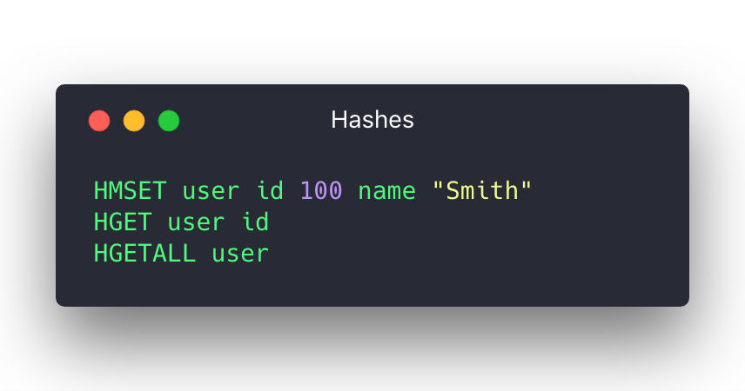
Redis command: Hashes

Slide 16
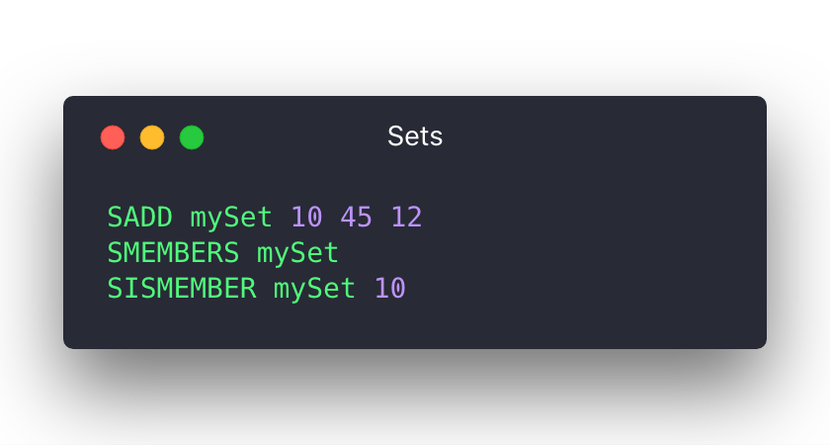
Redis command: Sets

Slide 17
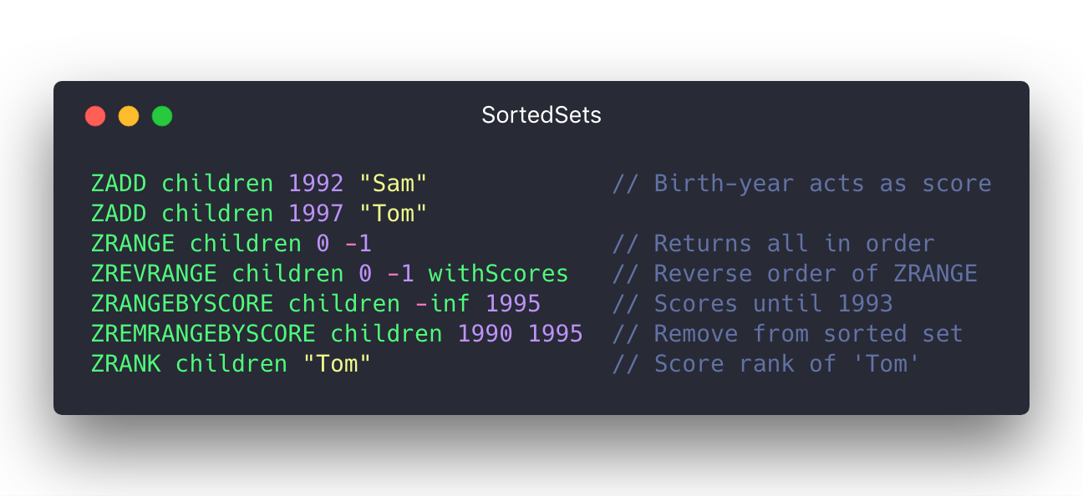
Redis command: Sorted sets

Slide 18
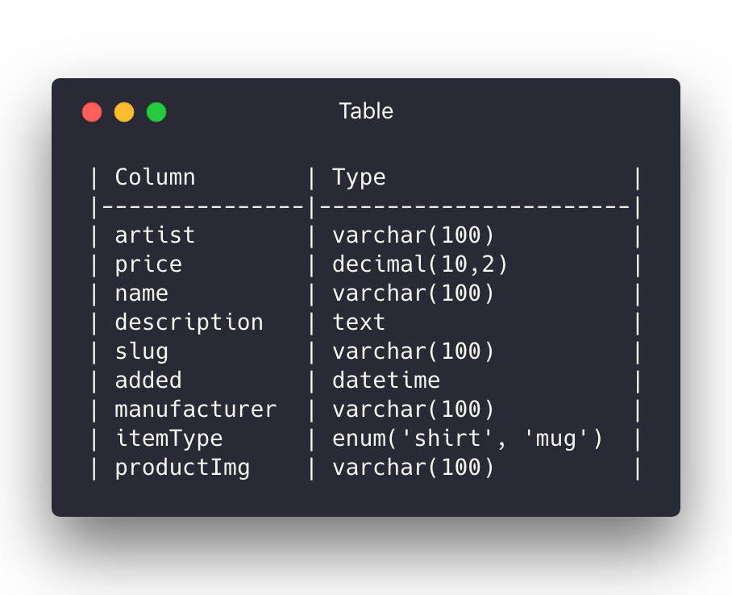
Redis vs SQL

Slide 19
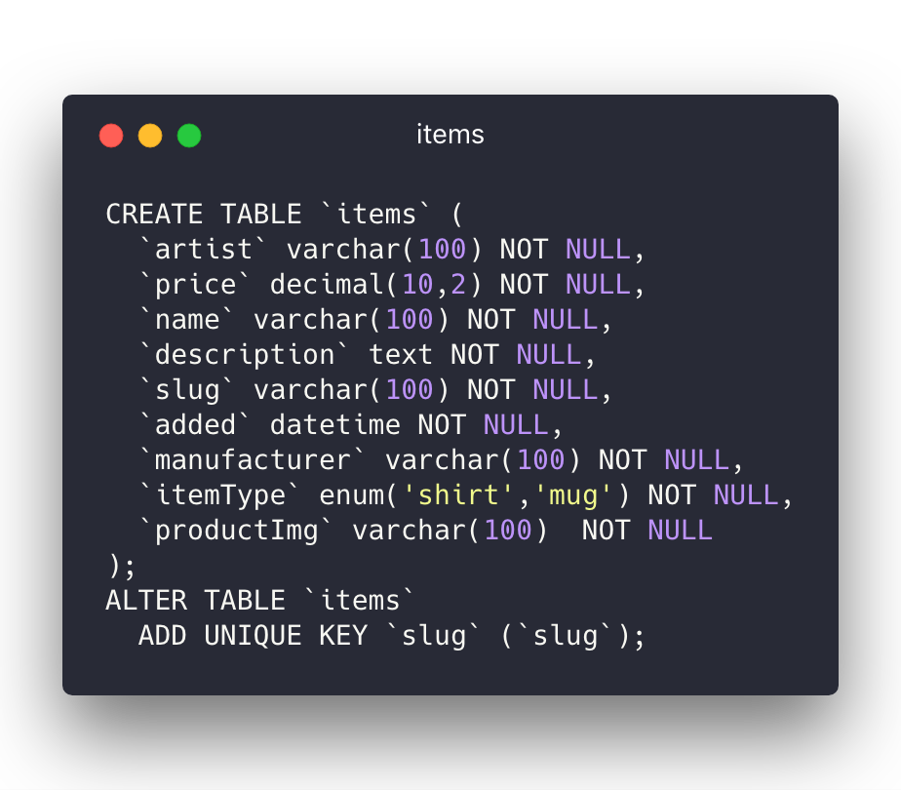
Redis vs SQL: Create Items’ table

Slide 20
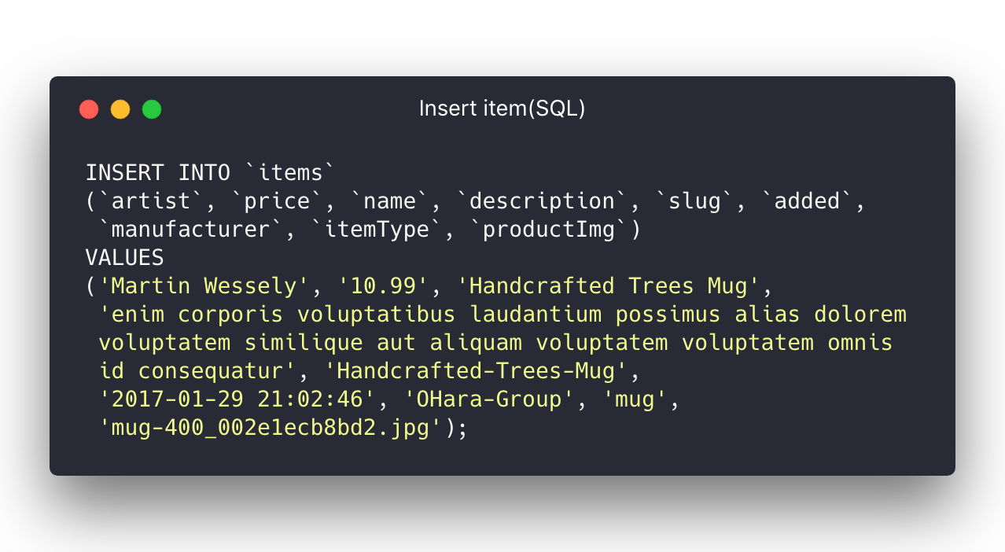
Redis vs SQL: Insert item into tables

Slide 21
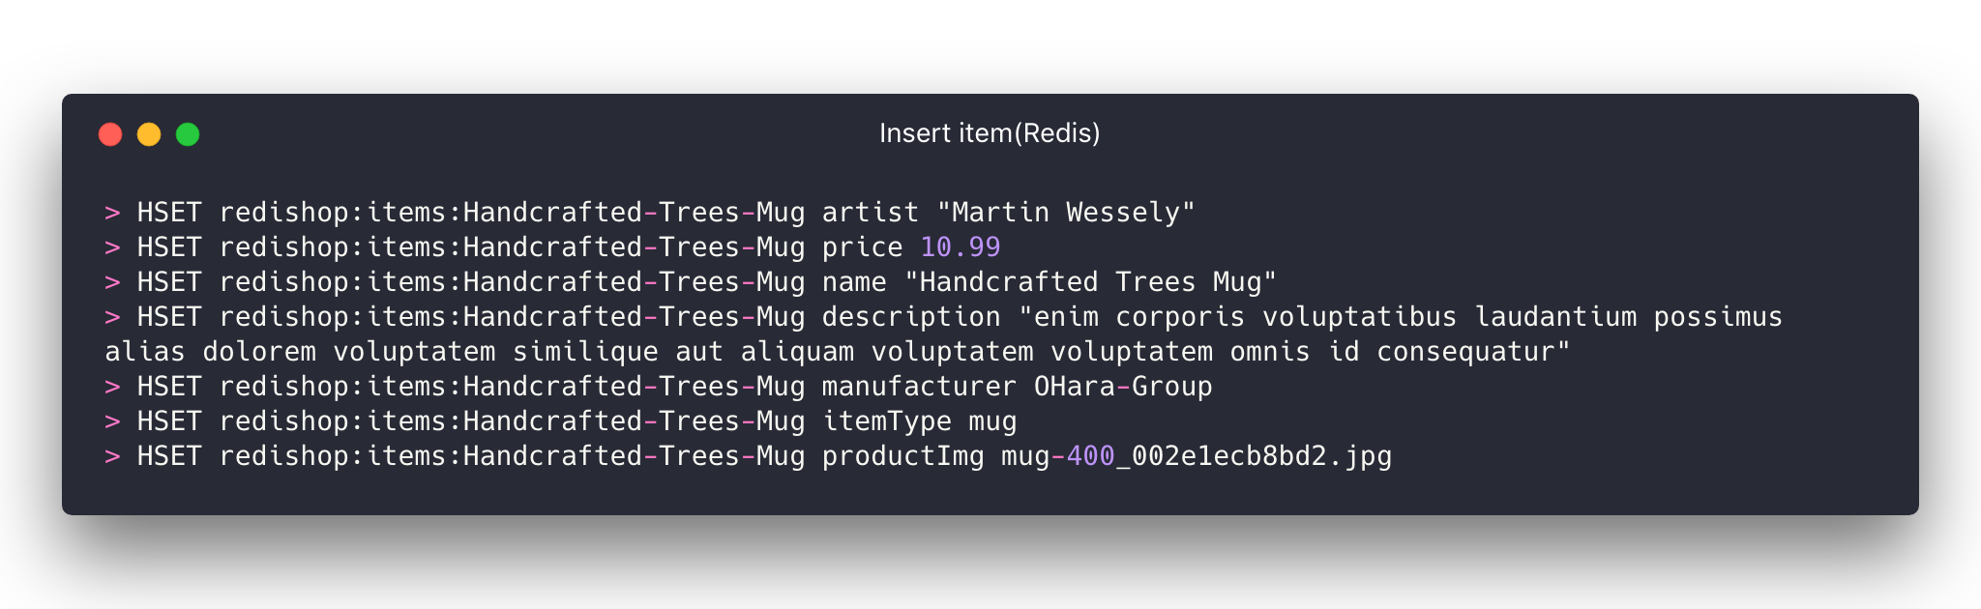
Redis vs SQL: Insert item into tables

Slide 22
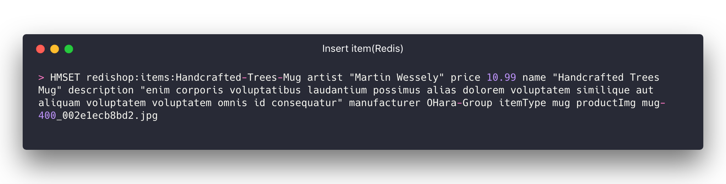
Redis vs SQL: Insert item into tables

